Slide 1

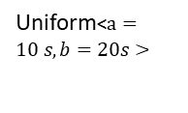





Exp<$λ=0.05 s−1>$
Cooling
P$CPU→Sensing$ = 0.5
P$CPU→Cooling$ = 0.3
Using CPU
Sensing
Erlang<$λ=0.1 s−1,k=3>$
Uniform<$a=10 s,b=20s>$
P$CPU→Heating$ = 0.2
Heating
Exp<$λ=0.03 s−1>$

